Slide 1
SAAM
Software architecture analysis method
http://slashnode.wikidot.com/seng4420-lect07

Slide 2
Software Architecture Analysis Method (SAAM)
Method to determine the degree to which an architecture meets its goals. It is used for:
  Validation during development / testing
  Benchmark when acquiring software
  Comparing architectures
First formalized architecture evaluation method
  Created in 1990s
  Introduced the idea of evaluation via scenarios

Slide 3
Assessments and Scenarios
Assessment is completed using scenarios.
  Scenario - brief description of a single interaction of a stakeholder with a system
  Scenario - sequence of steps involving the use or modification of the system
  e.g. customer requests a refund via the web portal. The system updates the order status and triggers a confirmation email
Not necessarily a run-time interaction
  e.g. performance stress test scenario, changes scenario, threat scenario, …
Scenarios test quality attributes, for example:
  By proposing specific changes to be made to a system - modifiability
  By proposing specific threat actions - security
  By proposing usage profiles that tax resources - performance
These quality attributes do not exist in isolation; the context of them is important. For example - a UI is careful designed so that a novice user can use the system with minimal training, but what if experienced users find it tedious?

Slide 4
SAAM Steps
Develop scenarios
Classify scenarios
Perform scenario evaluations
Reveal scenario interaction
Overall evaluation
Scenario ≠ Use Case
A use case describes functionality the system already has. A SAAM scenario is broader — it also includes indirect scenarios: hypothetical future changes (e.g. port to a new OS) that no use case would ever cover.

Slide 5
Step 1 – Develop Scenarios
Take into account
  System's expected qualities
  Uses
  Users
Scenarios represent tasks relevant to different stakeholders, so:
  Involve all stakeholders (devs, users, business, etc)
  Involve experts (domain & tech => technical realism)
  Cover both use (functionality) and change (evolution) scenarios
  Cover all important QAs (users – usability / performance, management – TTM / cost, etc)

Slide 6
Step 2 – Classify Scenarios
Scenarios can be divided into two groups:
  Direct scenarios – can be "walked through" the architecture
      e.g. adding a new user role (can use an existing role hierarchy)
  Indirect scenarios – require modification to the system (i.e. extra components & connectors)
      e.g. adding a new feature that requires a new service or / and DB schema changes
The split reveals architectural flexibility
  80% scenarios are indirect? Maybe the architecture is too rigid
  First numerical insight

Slide 7
Step 3 – Perform Scenario Evaluations
For each scenario
  List which components and/or connections need to be altered
  Weighting of the difficulty of the change(s)
  Estimated cost of the changes
    e.g. measured in effort (engineering hours)
  Description of the set of changes required
Scenario | Affected components | Difficulty | Cost | Description
Add new report | 3 services & data mart | High | 40 h | Modify 3 services Create 3 data pipelines Update data mart
Add payment type | 1 service | Low | 6 h | Implement new adapter

Slide 8
Step 4 – Reveal Scenario Interaction
Semantically different indirect scenarios require the same component to be changed (interacts with it?)
  "Semantically different" = scenarios serving unrelated concerns, not just worded differently
  Exposes flaws in functionality allocation / system decomposition
  Low cohesion
  High coupling
  High structural complexity
Semantically different, not just different
  e.g. different scenarios about user roles interact with the same component – good
High interaction between semantically related scenarios indicates high cohesion.

Slide 9
Step 5 – Overall Evaluation
If we are comparing architectures…
“Importance-weight" should be assigned to each scenario and the scenario interactions.
  Process involving all stakeholders
The weighting is used to determine an overall ranking of candidate architectures
Note: Weights and costs are subjective estimates from stakeholders/architects — no fixed numeric scale; this is a known SAAM limitation
Scenario | Weight | Arch A Cost | Arch B Cost
Add new report | 0.4 | 5 | 3
Add payment type | 0.6 | 9 | 4
Total (weighted) |  | 7.4 | 3.6

Slide 10
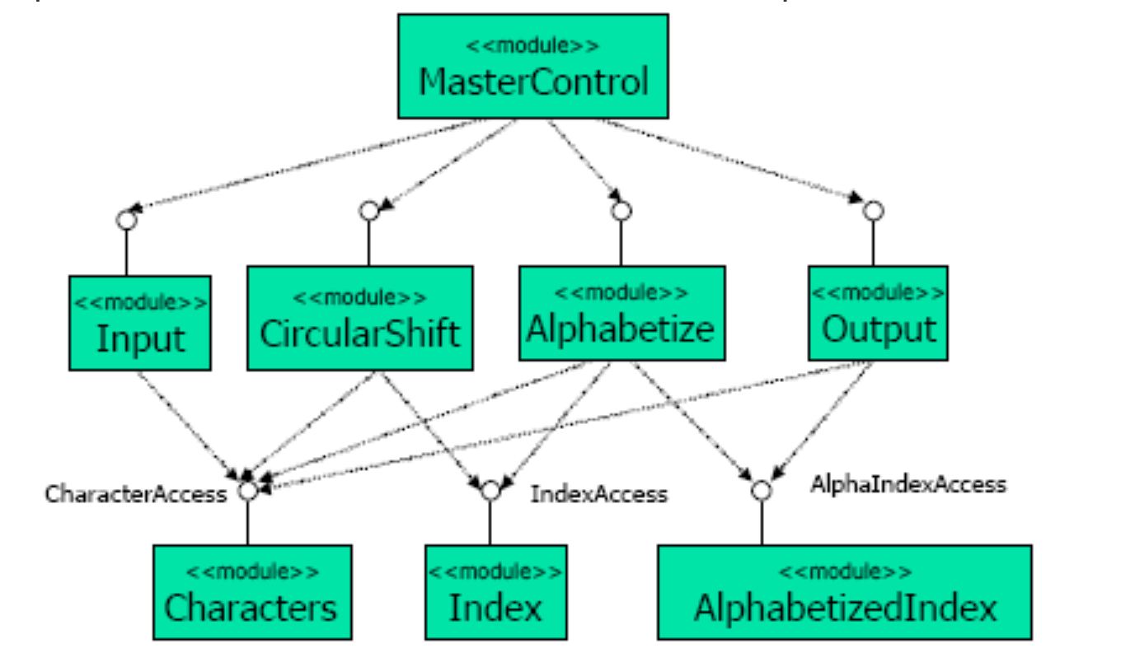
Example
Keyword in Context System (KWICS)
  Takes a set of sentences
  Shift circularly
  Produces all possible versions
  Alphabetize the result
  Completely useless now
  Used 50-60 years ago
  No digital text search
  Print the index on paper
  Keep the context close
  Easy to search due to alphabetical sorting
Input: "the dog in the park"
Output:
dog in the park / the
in the park / the dog
park / the dog in the
the dog in the park
the park / the dog in

Slide 11
Developing scenarios
KWICS has two stakeholders
  End user
  Developer
Scenario 1: Make KWICS operate in an incremental rather than batch fashion
  Accept one sentence at a time and produce the keyword index for all sentences given to date
Scenario 2: Make KWICS eliminate entries beginning with noise words (articles, pronouns, prepositions and conjunctions)
Scenario 3: Change the internal representation of the sentences (i. e. compressed or uncompressed)

Slide 12
Scenario 1: Batch → Incremental
This will most likely require modification of:
  Input – yield control to MasterControl after each sentence.
  Alphabetizer – use incremental sorting rather than sorting all at once.
  MasterControl – loop over subordinate modules for each sentence.
Weight, Difficulty & Cost
  Weight: 0.3 – nice-to-have throughput improvement
  Difficulty: Medium–High – spans 3 modules and touches
    core control flow
  Cost: ~24 h (estimate)

Slide 13
Scenario 2: Eliminate Noise Words
Probably will require modification of:
  CircularShift : to delete those sentences beginning with 'noise' words
Weight, Difficulty & Cost
  Weight: 0.2 – minor usability polish
  Difficulty: Low – isolated to a single module
  Cost: ~4 h (estimate)

Slide 14
Scenario 3: Change Internal Representation
Will require modification of:
  Characters: needs to be changed to handle compressed data
  Note: as all modules use Characters all modules (other than MasterControl) may need modifying
    Refactor into an isolated Line Storage module?
Weight, Difficulty & Cost
  Weight: 0.5 – strategic compression capability
  Difficulty: High – ripples through nearly every module
  Cost: ~60 h (estimate)

Slide 15
Scenario Interaction
Comparing affected components across the 3 scenarios reveals coupling:
  Scenario 1 & 3 share Input and Alphabetizer
  Scenario 2 & 3 share CircularShift
  Scenario 1 & 2 share nothing — no interaction
  Scenarios 1 & 3 are semantically unrelated (control flow vs. data representation) yet share 2 modules — a coupling red flag (see Step 4)
Scenario Pair | Shared Component | Interaction
1 & 2 | None | None
2 & 3 | CircularShift | Moderate
1 & 3 | Input, Alphabetizer | High

Slide 16
Overall Evaluation
Step 5 combines each scenario's weight and cost into an overall score for the architecture:
  Overall score = Σ (weight × cost) across all scenarios
  KWICS's current design scores 38.0 — driven almost entirely by Scenario 3
  An alternative design with an isolated Line Storage module (slide 14) would only need to change that one module for Scenario 3 — sharply lowering its total score and making it the better architecture by this method
Scenario | Weight | Cost | Weight × Cost
S1: Batch→Incr. | 0.3 | 24h | 7.2
S2: Noise Words | 0.2 | 4h | 0.8
S3: Internal Rep. | 0.5 | 60h | 30.0
Total | 1.0 | 88h | 38.0

